Slide 1

Machine Learning
Studies how to automatically learn to make accurate predictions based on past observations.
In the terminology of machine learning, classification is considered an instance of supervised learning, i.e., learning where a training set of correctly identified observations is available.
Machine Learning Cycle includes the following steps :
->Planning ->Data Preparation ->Modelling ->Model Presentation
Notes:
1

Slide 2
Classification
Classification is the problem of identifying to which set of categories (sub-populations) a new observation belongs.
On the basis of a training set of data containing observations (or instances) whose category membership is known.
A classification model attempts to draw some conclusion from observed values. Given one or more inputs a classification model will try to predict the value of one or more outcomes.
When we are trying to predict a categorical or nominal variable,the problem is classification,where the output variable is a category such as ‘red’ or ‘blue’,whereas when we are trying to predict a numerical variable such as ‘price’,’weight’ etc..,the problem falls under regression.
Notes:
2

Slide 3
Classification
For example, when filtering emails “spam” or “not spam”, when looking at transaction data, “fraudulent”, or “authorized”.
In short Classification either predicts categorical class labels or classifies data (construct a model) based on the training set and the values (class labels) in classifying attributes and uses it in classifying new data.
Notes:
3

Slide 4
Examples of Classification Problems:
Text categorization (e.g., spam filtering)
Fraud detection
Optical character recognition
Machine vision (e.g., face detection)
Natural-language processing (e.g., spoken language understanding)
Market segmentation (e.g.: predict if customer will respond to promotion)
Bioinformatics (e.g., classify proteins according to their function)
Notes:
4

Slide 5
Common Classification Algorithms:
Logistic Regression (Linear Classifier-output is weighted sum of inputs)
Naïve Bayes Classifier
Support Vector Machine
Decision Tree
Random Forest
K-Nearest Neighbour (KNN)
Notes:
5

Slide 6
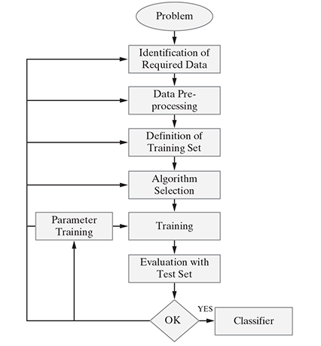
Classification Learning Steps
Notes:
6

Slide 7
Logistic Regression

Slide 8
Introduction
Supervised Learning
Classification Problem
When we classify only two classes it is called Binary Classification problem.
Logistic Regression is a type of regression analysis used for predicting the outcome of categorical dependent variable.
Dependent variable(Y) is binary(0,1) and independent variables (X) are continuous in nature.
Dependent variable can take only two possible values such as “Yes or No”, “Default or No Default”, “Living or Dead”, “Responder or Non Responder”, “Yes or No” etc.

Slide 9
Why not use linear regression??

Slide 10
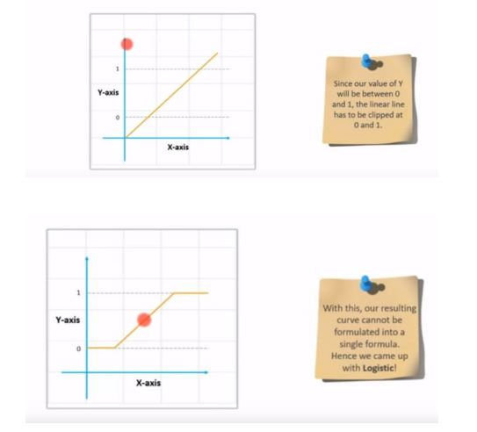

Slide 11

Logistic Regression
The dependent variable Y must be categorical (1/0) and take binary value.
e.g: if pass then Y = 1;else Y = 0
We need a hypothesis function or we can call it a model.
The output of this hypothesis should be between 0 and 1.
We use sigmoid function as the hypothesis.
Thus the goal of the Logistic Regression is to predict the likelihood that Y is equal to 1 (probability that Y = 1 rather than 0),given certain values of X.

Slide 12
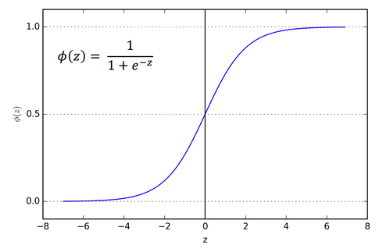
Why Sigmoid??

Slide 13
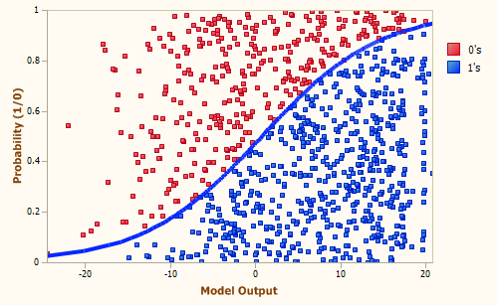
Binary Classification

Slide 14
Decision Boundary
We deal with thresholds here.
Suppose if we have any value at 0.8 then we define threshold and if the value is greater than threshold that will be rounded off to 1,less than threshold rounded off to 0,in order to find the output
If hypothesis >= 0.5 yhat = 1
else yhat = 0
Here Theta’s play an important role in creating the decision boundary
Once we have the decision boundary set we will not need any data to predict the output

Slide 15
Cost Function
This is the cost function we used previously:
Here we introduce a new kind of loss function called cross entropy loss.

Slide 16
Cross entropy loss
We will define loss function for logistic regression like this:
cost(h(x),y) = -log(h(x)) if y = 1
= -log(1-h(x)) if y = 0
So, we derive the loss function from the above formula with the help of principle of maximum likelyhood estimation

Slide 17
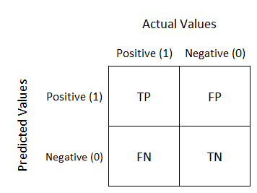
Evaluation Metrics
There will be four possibilities if we consider a match win/loss prediction:
Model Predicted win and team win – True Positive (TP)
Model Predicted win and team lost – False Positive (FP)
Model Predicted loss and team win – False Negative (FN)
Model Predicted loss and team loss – True Negative (TN)
Confusion Matrix is the Classification Metric used to describe the performance of a classification model on a set of test data for which the true values are known.

Slide 18
Evaluation Metrics
Model accuracy - Accuracy is the most intuitive performance measure and it is simply a ratio of correctly predicted observation to the total observations.
TP+TN / TP+FP+FN+TN
Precision- Precision is the ratio of correctly predicted positive observations to the total predicted positive observations
TP / TP + FP
Recall(Sensitivity) It is the ratio of correctly predicted positive observations to the all observations in actual class - yes TP / TP + FN
F-Measure It is the weighted average of Precision and Recall. Therefore, this score takes both false positives and false negatives into account
2 * Precision * Recall / Precision + Recall

Slide 19
AUC – ROC Curve
AUC - ROC curve is a performance measurement for classification problem at various thresholds settings. ROC is a probability curve and AUC represents degree or measure of separability
Higher the AUC, better the model is at predicting 0s as 0s and 1s as 1s.
The ROC curve is plotted with TPR against the FPR where TPR is on Y-axis and FPR is on the X-axis.
Thus ROC summarizes the model’s performance by evaluating the trade offs between True Positive Rate (Sensitivity) and False Positive Rate (1- Specificity).
TPR = TP / TP + FN
FPR = FP / FP + TN

Slide 20
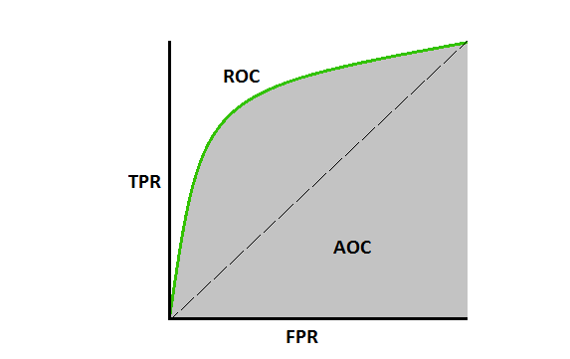
An excellent model has AUC near to the 1 which means it has good measure of separability. A poor model has AUC near to the 0 which means it has worst measure of separability.

